Slide 1
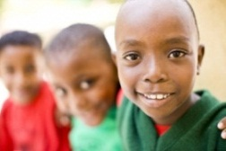
This project and its actions were made possible due to co-financing by the European Fund for the Integration of Third-Country Nationals
EAL Nexus resource
Winnie the Witch
Matching and substitution tables
Subject: | English
Age groups: | 0–4, 5–7
Topic: | Winnie the Witch
Licence information | This resource is free to use for educational purposes. ©British Council 2015
Source | This resource was originally developed by Linda Edwardson and has been adapted by EAL Nexus.

Slide 2
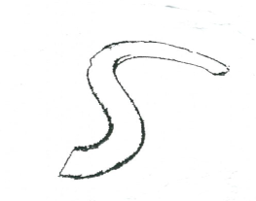
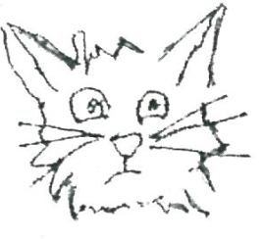
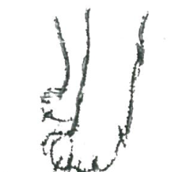
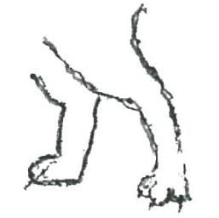
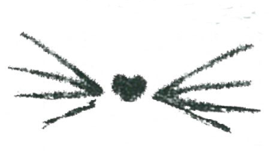

Slide 4
tail
green
body
purple
head
blue
front legs
yellow
back legs
red
whiskers
pink

Slide 5
.
Wilbur’s
went

Slide 6
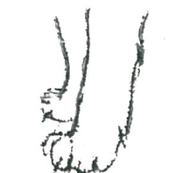
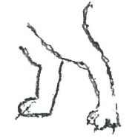
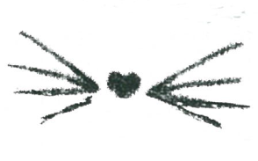
tail
green
body
purple
.
head
Wilbur’s
went
blue
front legs
yellow
back legs
red
whiskers
pink

Slide 7
is
.
Wilbur’s
are

Slide 8
tail
green
body
purple
is
.
head
Wilbur’s
blue
front legs
are
yellow
back legs
red
whiskers
pink

